Slide 1
Elements of Syntax for Parsing
COSI 114 – Computational Linguistics
James Pustejovsky
April 1, 2021
Brandeis University

Slide 2
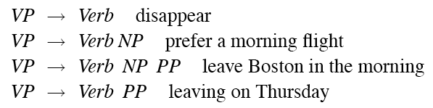
Verb Phrases
English VPs consist of a head verb along with 0 or more following constituents which we’ll call arguments.

Slide 3
Subcategorization
Even though there are many valid VP rules in English, not all verbs are allowed to participate in all those VP rules.
We can subcategorize the verbs in a language according to the sets of VP rules that they participate in.
This is just an elaboration on the traditional notion of transitive/intransitive.
Modern grammars have many such classes

Slide 4
Subcategorization
Sneeze: John sneezed
Find: Please find [a flight to NY]_{NP}
Give: Give [me]_{NP}[a cheaper fare]_{NP}
Help: Can you help [me]_{NP}[with a flight]_{PP}
Prefer: I prefer [to leave earlier]_{TO-VP}
Told: I was told [United has a flight]_{S}
…

Slide 5
Programming Analogy
It may help to view things this way
  Verbs are functions or methods
  They participate in specify the number, position, and type of the arguments they take...
    That is, just like the formal parameters to a method.

Slide 6
Subcategorization
*John sneezed the book
*I prefer United has a flight
*Give with a flight
As with agreement phenomena, we need a way to formally express these facts

Slide 7
Why?
Right now, the various rules for VPs overgenerate.
  They permit the presence of strings containing verbs and arguments that don’t go together
  For example
  VP -> V NP therefore
  Sneezed the book is a VP since “sneeze” is a verb and “the book” is a valid NP

Slide 8
Possible CFG Solution
Possible solution for agreement.
Can use the same trick for all the verb/VP classes.
SgS -> SgNP SgVP
PlS -> PlNp PlVP
SgNP -> SgDet SgNom
PlNP -> PlDet PlNom
PlVP -> PlV NP
SgVP ->SgV Np
…

Slide 9
CFG Solution for Agreement
It works and stays within the power of CFGs
  But it is a fairly ugly one
And it doesn’t scale all that well because of the interaction among the various constraints explodes the number of rules in our grammar.

Slide 10
Summary
CFGs appear to be just about what we need to account for a lot of basic syntactic structure in English.
But there are problems
  That can be dealt with adequately, although not elegantly, by staying within the CFG framework.
There are simpler, more elegant, solutions that take us out of the CFG framework (beyond its formal power)
  LFG, HPSG, Construction grammar, XTAG, etc.
  Chapter 15 explores one approach (feature unification) in more detail

Slide 11
Treebanks
Treebanks are corpora in which each sentence has been paired with a parse structure (presumably the correct one).
These are generally created
  By first parsing the collection with an automatic parser
  And then having human annotators hand correct each parse as necessary.
This generally requires detailed annotation guidelines that provide a POS tagset, a grammar, and instructions for how to deal with particular grammatical constructions.

Slide 12
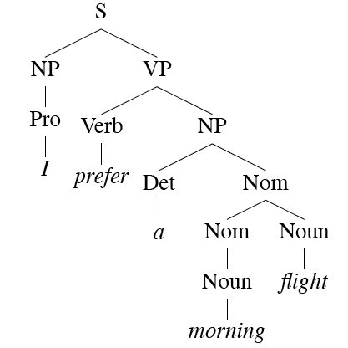
Parens and Trees
(S (NP (Pro I))
(VP (Verb prefer)
(NP (Det a)
(Nom (Nom (Noun morning))
(Noun flight)))))

Slide 13
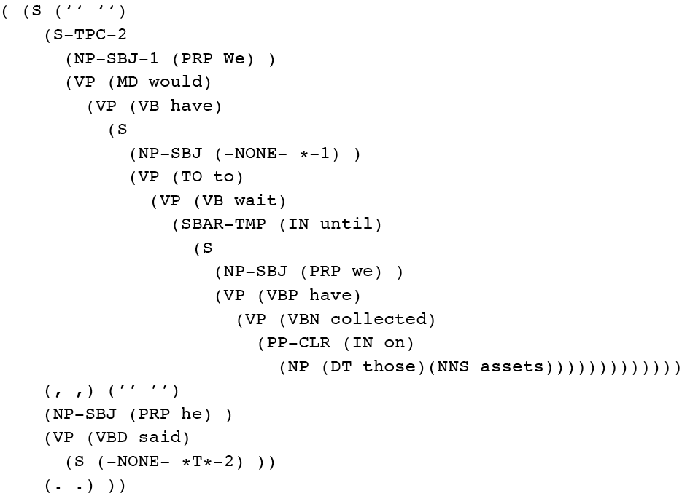
Penn Treebank
Penn TreeBank is a widely used treebank.
  Most well known part is the Wall Street Journal section of the Penn TreeBank.
    1 M words from the 1987-1989 Wall Street Journal.

Slide 14
Treebank Grammars
Treebanks implicitly define a grammar for the language covered in the treebank.
Simply take the local rules that make up the sub-trees in all the trees in the collection and you have a grammar
  The WSJ section gives us about 12k rules if you do this
Not complete, but if you have decent size corpus, you will have a grammar with decent coverage.

Slide 15


Treebank Grammars
Such grammars tend to be very flat due to the fact that they tend to avoid recursion.
  To ease annotator’s burden, among things
For example, the Penn Treebank has ~4500 different rules for VPs. Among them...

Slide 16
Treebank Uses
Treebanks (and head-finding) are particularly critical to the development of statistical parsers
  Chapter 14
    We will get there
Also valuable to Corpus Linguistics
  Investigating the empirical details of various constructions in a given language
    How often do people use various constructions and in what contexts...
    Do people ever say X ...

Slide 17
Head Finding
Finding heads in treebank trees is a task that arises frequently in many applications.
  As we’ll see it is particularly important in statistical parsing
We can visualize this task by annotating the nodes of a parse tree with the heads of each corresponding node.

Slide 18
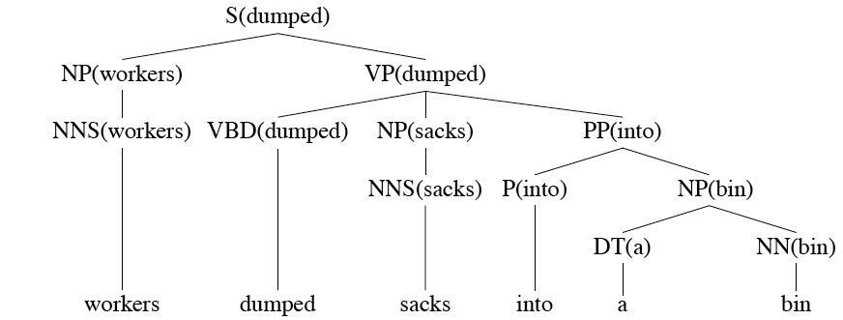
Lexically Decorated Tree

Slide 19
Head Finding
Given a tree, the standard way to do head finding is to use a simple set of tree traversal rules specific to each non-terminal in the grammar.

Slide 20
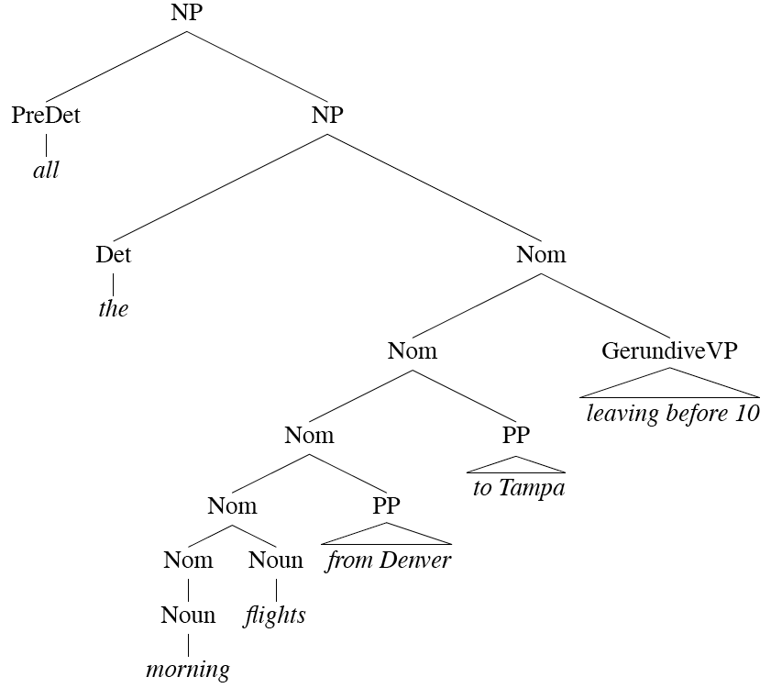
Noun Phrases

Slide 21
Treebank Uses
Treebanks (and head-finding) are particularly critical to the development of statistical parsers
  Chapter 14
Also valuable to Corpus Linguistics
  Investigating the empirical details of various constructions in a given language

Slide 22
Dependency Grammars
In CFG-style phrase-structure grammars the main focus is on constituents and ordering.
But it turns out you can get a lot done with just labeled relations among the words in an utterance.
In a dependency grammar framework, a parse is a tree where
  The nodes stand for the words in an utterance
  The links between the words represent dependency relations between pairs of words.
    Relations may be typed (labeled), or not.

Slide 23
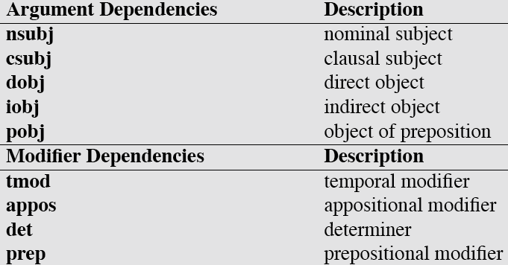
Dependency Relations

Slide 24
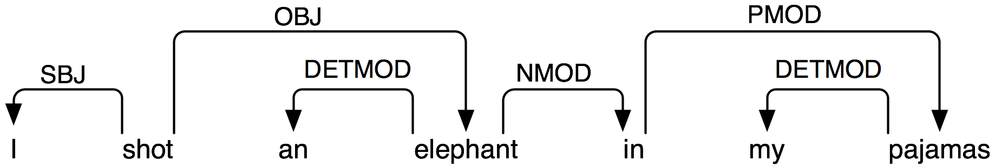
Dependency Parse

Slide 25
Dependency Parsing
The dependency approach has a number of advantages over full phrase-structure parsing.
  It deals well with free word order languages where the constituent structure is quite fluid
  Parsing is much faster than with CFG-based parsers
  Dependency structure often captures the syntactic relations needed by later applications
    CFG-based approaches often extract this same information from trees anyway

Slide 26
Summary
Context-free grammars can be used to model various facts about the syntax of a language.
When paired with parsers, such grammars consititute a critical component in many applications.
Constituency is a key phenomena easily captured with CFG rules.
  But agreement and subcategorization do pose significant problems
Treebanks pair sentences in corpus with their corresponding trees.

Slide 27
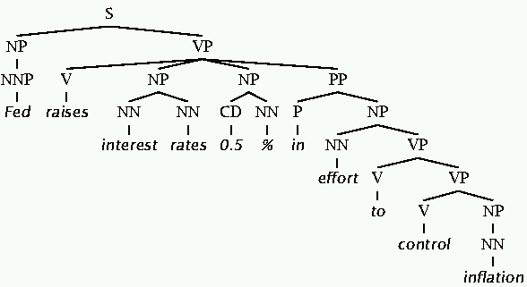
1. Phrase structure
Phrase structure trees organize sentences into constituents or brackets.
Each constituent gets a label.
The constituents are nested in a tree form.
Linguists can and do argue about the details.
Lots of ambiguity …

Slide 28
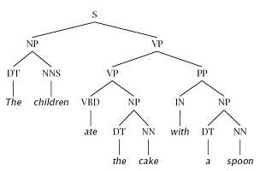
Constituency Tests
How do we know what nodes go in the tree?
Classic constituency tests:
  Substitution by proform
  Question answers
  Semantic grounds
    Coherence
    Reference
    Idioms
  Dislocation
  Conjunction
Cross-linguistic arguments

Slide 29
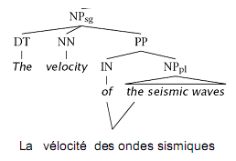
Conflicting Tests
Constituency isn’t always clear.
Phonological Reduction:
  I will go → I’ll go
  I want to go → I wanna go
  a le centre → au centre
Coordination
  He went to and came from the store.

Slide 30
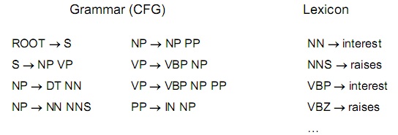
Classical NLP: Parsing
Write symbolic or logical rules:
Use deduction systems to prove parses from words
  Minimal grammar on “Fed” sentence: 36 parses
  Simple, 10-rule grammar: 592 parses
  Real-size grammar: many millions of parses
  With hand-built grammar, ~30% of sentences have no parse
This scales very badly.
  Hard to produce enough rules for every variation of language (coverage)
  Many, many parses for each valid sentence (disambiguation)

Slide 31
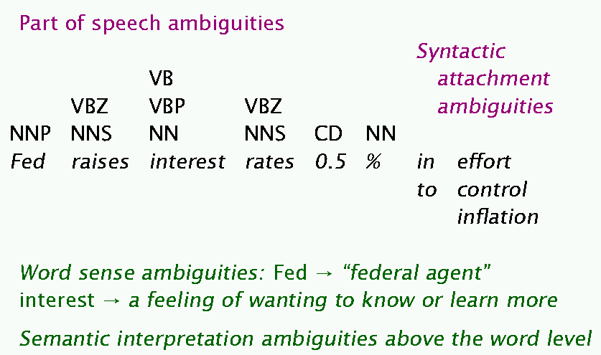
Ambiguity examples

Slide 32
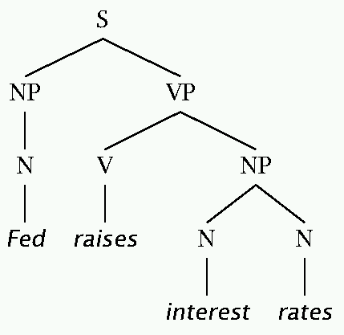
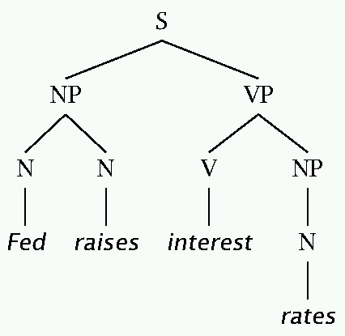
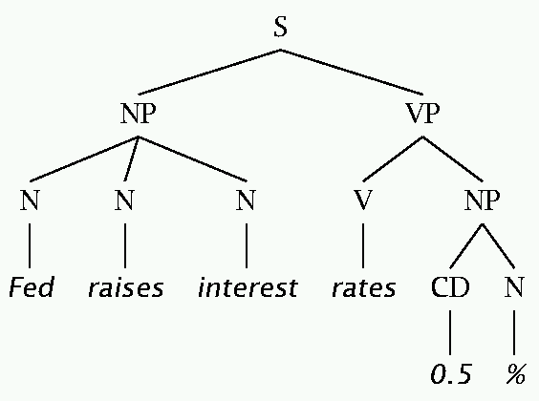
The bad effects of V/N ambiguities

Slide 33
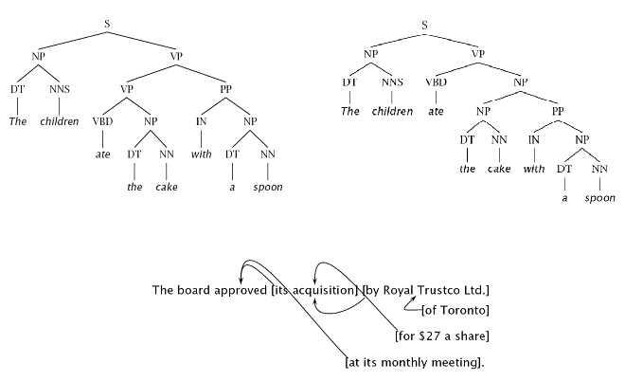
Ambiguities: PP Attachment

Slide 34
Attachments
I cleaned the dishes from dinner.
I cleaned the dishes with detergent.
I cleaned the dishes in my pajamas.
I cleaned the dishes in the sink.

Slide 35
Syntactic Ambiguities 1
Prepositional Phrases
  They cooked the beans in the pot on the stove with handles.
Particle vs. Preposition
  The puppy tore up the staircase.
Complement Structure
  The tourists objected to the guide that they couldn’t hear.
  She knows you like the back of her hand.
Gerund vs. Participial Adjective
  Visiting relatives can be boring.
  Changing schedules frequently confused passengers.

Slide 36
Syntactic Ambiguities 2
Modifier scope within NPs
  impractical design requirements
  plastic cup holder
Multiple gap constructions
  The chicken is ready to eat.
  The contractors are rich enough to sue.
Coordination scope
  Small rats and mice can squeeze into holes or cracks in the wall.

Slide 37
Classical NLP Parsing:
The problem and its solution
Very constrained grammars attempt to limit unlikely/weird parses for sentences
  But the attempt makes the grammars not robust: many sentences have no parse
A less constrained grammar can parse more sentences
  But simple sentences end up with ever more parses
Solution: We need mechanisms that allow us to find the most likely parse(s)
  Statistical parsing lets us work with very loose grammars that admit millions of parses for sentences but to still quickly find the best parse(s)

Slide 38
Polynomial-time Parsing with
Context Free Grammars

Slide 39
Parsing
Computational task:
Given a set of grammar rules and a sentence, find a valid parse of the sentence (efficiently)
Naively, you could try all possible trees until you get to a parse tree that conforms to the grammar rules, that has “S” at the root, and that has the right words at the leaves.
But that takes exponential time in the number of words.

Slide 40
Aspects of parsing
Running a grammar backwards to find possible structures for a sentence
Parsing can be viewed as a search problem
Parsing is a hidden data problem
For the moment, we want to examine all structures for a string of words
We can do this bottom-up or top-down
  This distinction is independent of depth-first or breadth-first search – we can do either both ways
  We search by building a search tree which his distinct from the parse tree

Slide 41
Human parsing
Humans often do ambiguity maintenance
  Have the police … eaten their supper?
  come in and look around.
  taken out and shot.
But humans also commit early and are “garden pathed”:
  The man who hunts ducks out on weekends.
  The cotton shirts are made from grows in Mississippi.
  The horse raced past the barn fell.

Slide 42
A phrase structure grammar
S → NP VP N → cats
VP → V NP N → claws
VP → V NP PP N → people
NP → NP PP N → scratch
NP → N V → scratch
NP → e P → with
NP → N N
PP → P NP
By convention, S is the start symbol, but in the PTB, we have an extra node at the top (ROOT, TOP)
Notes:
Cats scratch people with people with cats with claws.

Slide 43
Phrase structure grammars = context-free grammars
G = (T, N, S, R)
  T is set of terminals
  N is set of nonterminals
    For NLP, we usually distinguish out a set P ⊂ N of preterminals, which always rewrite as terminals
    S is the start symbol (one of the nonterminals)
    R is rules/productions of the form X → γ, where X is a nonterminal and γ is a sequence of terminals and nonterminals (possibly an empty sequence)
A grammar G generates a language L.

Slide 44
Probabilistic or stochastic context-free grammars (PCFGs)
G = (T, N, S, R, P)
  T is set of terminals
  N is set of nonterminals
    For NLP, we usually distinguish out a set P ⊂ N of preterminals, which always rewrite as terminals
    S is the start symbol (one of the nonterminals)
    R is rules/productions of the form X → γ, where X is a nonterminal and γ is a sequence of terminals and nonterminals (possibly an empty sequence)
    P(R) gives the probability of each rule.
A grammar G generates a language model L.

Slide 45
Soundness and completeness
A parser is sound if every parse it returns is valid/correct
A parser terminates if it is guaranteed to not go off into an infinite loop
A parser is complete if for any given grammar and sentence, it is sound, produces every valid parse for that sentence, and terminates
(For many purposes, we settle for sound but incomplete parsers: e.g., probabilistic parsers that return a k-best list.)

Slide 46
Top-down parsing
Top-down parsing is goal directed
A top-down parser starts with a list of constituents to be built. The top-down parser rewrites the goals in the goal list by matching one against the LHS of the grammar rules, and expanding it with the RHS, attempting to match the sentence to be derived.
If a goal can be rewritten in several ways, then there is a choice of which rule to apply (search problem)
Can use depth-first or breadth-first search, and goal ordering.

Slide 47

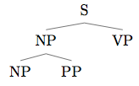

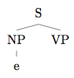
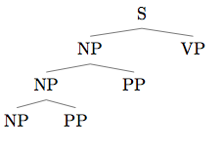
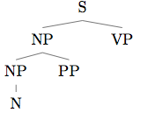
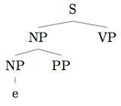

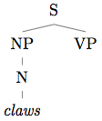
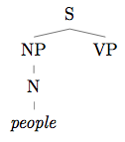
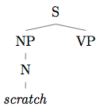
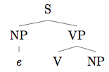
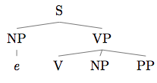
Top-down parsing

Slide 48
Problems with top-down parsing
Left recursive rules
A top-down parser will do badly if there are many different rules for the same LHS. Consider if there are 600 rules for S, 599 of which start with NP, but one of which starts with V, and the sentence starts with V.
Useless work: expands things that are possible top-down but not there
Top-down parsers do well if there is useful grammar-driven control: search is directed by the grammar
Top-down is hopeless for rewriting parts of speech (preterminals) with words (terminals). In practice that is always done bottom-up as lexical lookup.
Repeated work: anywhere there is common substructure

Slide 49
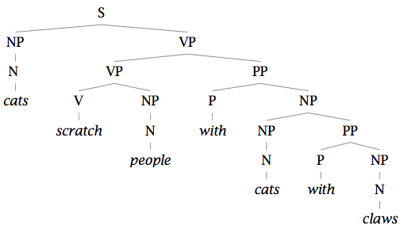
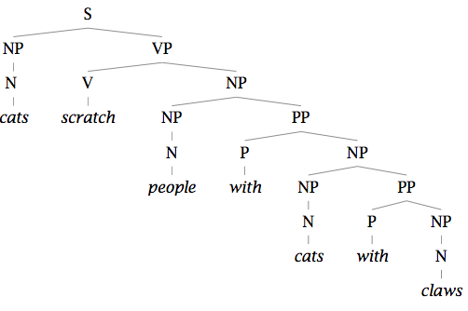
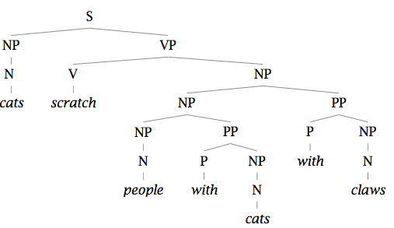
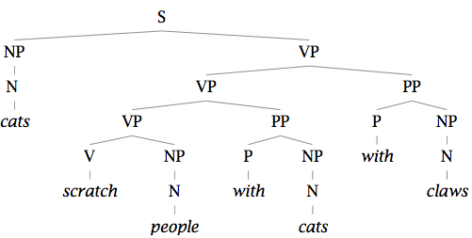
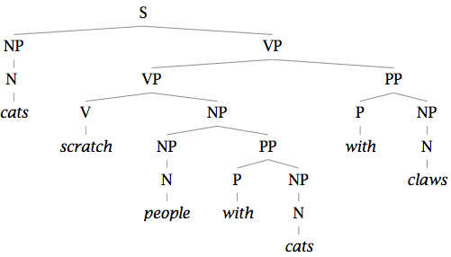
Repeated work…

Slide 50
Bottom-up parsing
Bottom-up parsing is data directed
The initial goal list of a bottom-up parser is the string to be parsed. If a sequence in the goal list matches the RHS of a rule, then this sequence may be replaced by the LHS of the rule.
Parsing is finished when the goal list contains just the start category.
If the RHS of several rules match the goal list, then there is a choice of which rule to apply (search problem)
Can use depth-first or breadth-first search, and goal ordering.
The standard presentation is as shift-reduce parsing.

Slide 51
Problems with bottom-up parsing
Unable to deal with empty categories: termination problem, unless rewriting empties as constituents is somehow restricted (but then it's generally incomplete)
Useless work: locally possible, but globally impossible.
Inefficient when there is great lexical ambiguity (grammar-driven control might help here)
Conversely, it is data-directed: it attempts to parse the words that are there.
Repeated work: anywhere there is common substructure

Slide 52
Chomsky Normal Form
All rules are of the form X → Y Z or X → w.
A transformation to this form doesn’t change the weak generative capacity of CFGs.
  With some extra book-keeping in symbol names, you can even reconstruct the same trees with a detransform
  Unaries/empties are removed recursively
  N-ary rules introduce new nonterminals:
    VP → V NP PP becomes VP → V @VP-V and @VP-V → NP PP
In practice it’s a pain
  Reconstructing n-aries is easy
  Reconstructing unaries can be trickier
But it makes parsing easier/more efficient

Slide 53
For Now
Assume…
  You have all the words already in some buffer
  The input is not POS tagged prior to parsing
  We won’t worry about morphological analysis
  All the words are known
  These are all problematic in various ways, and would have to be addressed in real applications.

Slide 54
Top-Down Search
Since we’re trying to find trees rooted with an S (Sentences), why not start with the rules that give us an S.
Then we can work our way down from there to the words.

Slide 55
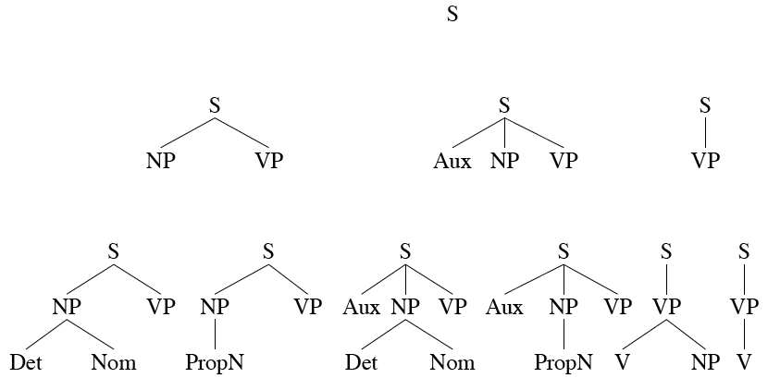
Top Down Space

Slide 56
Bottom-Up Parsing
Of course, we also want trees that cover the input words. So we might also start with trees that link up with the words in the right way.
Then work your way up from there to larger and larger trees.

Slide 57
Bottom-Up Search

Slide 58

Bottom-Up Search

Slide 59
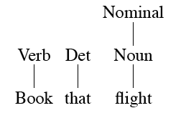
Bottom-Up Search

Slide 60
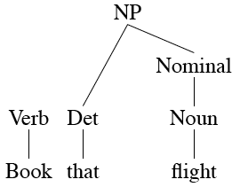
Bottom-Up Search

Slide 61
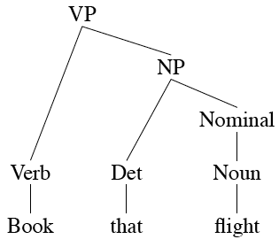
Bottom-Up Search

Slide 62
Top-Down and Bottom-Up
Top-down
  Only searches for trees that can be answers (i.e. S’s)
  But also suggests trees that are not consistent with any of the words
Bottom-up
  Only forms trees consistent with the words
  But suggests trees that make no sense globally

Slide 63
Control
Of course, in both cases we left out how to keep track of the search space and how to make choices
  Which node to try to expand next
  Which grammar rule to use to expand a node
One approach is called backtracking.
  Make a choice, if it works out then fine
  If not then back up and make a different choice

Slide 64
Problems
Even with the best filtering, backtracking methods are doomed because of two inter-related problems
  Ambiguity and search control (choice)
  Shared subproblems

Slide 65
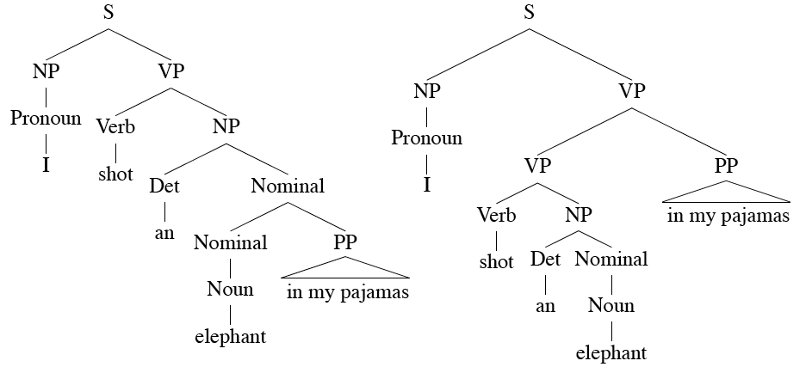
Ambiguity

Slide 66
Shared Sub-Problems
No matter what kind of search (top-down or bottom-up or mixed) that we choose...
  We can’t afford to redo work we’ve already done.
  Without some help naïve backtracking will lead to such duplicated work.

Slide 67
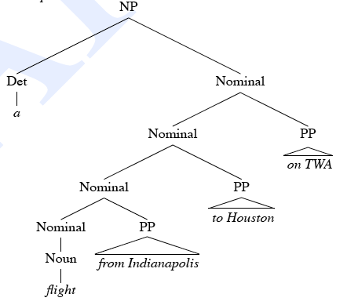
Shared Sub-Problems
Consider
  A flight from Indianapolis to Houston on TWA

Slide 68
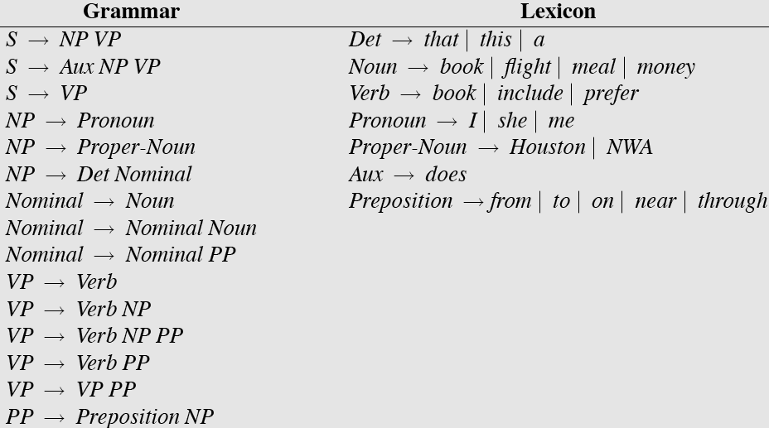
Sample L1 Grammar

Slide 69
Shared Sub-Problems
Assume a top-down parse that has already expanded the NP rule (dealing with the Det)
Now its making choices among the various Nominal rules
In particular, between these two
  Nominal -> Noun
  Nominal -> Nominal PP
Statically choosing the rules in this order leads to the following bad behavior...

Slide 70
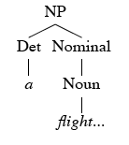
Shared Sub-Problems

Slide 71
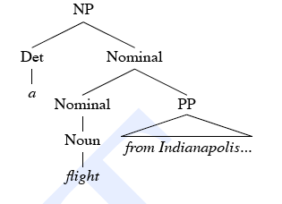
Shared Sub-Problems

Slide 72
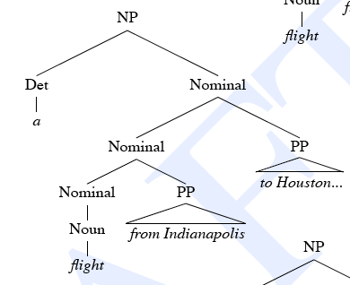
Shared Sub-Problems

Slide 73
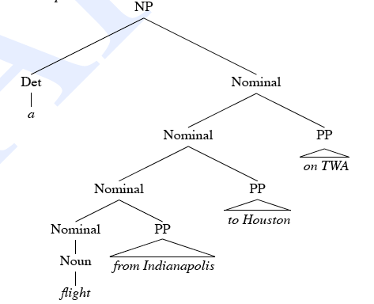
Shared Sub-Problems

Slide 74
Dynamic Programming
DP search methods fill tables with partial results and thereby
  Avoid doing avoidable repeated work
  Solve exponential problems in polynomial time (well not really)
  Efficiently store ambiguous structures with shared sub-parts.
We’ll cover two approaches that roughly correspond to top-down and bottom-up approaches.
  CKY
  Earley

Slide 75
CKY Parsing
First we’ll limit our grammar to epsilon-free, binary rules (more on this later)
Consider the rule A → BC
  If there is an A somewhere in the input generated by this rule then there must be a B followed by a C in the input.
  If the A spans from i to j in the input then there must be some k st. i<k<j
    In other words, the B splits from the C someplace after the i and before the j.

Slide 76
CKY
Build a table so that an A spanning from i to j in the input is placed in cell [i,j] in the table.
  So a non-terminal spanning an entire string will sit in cell [0, n]
    Hopefully it will be an S
Now we know that the parts of the A must go from i to k and from k to j, for some k

Slide 77
CKY
Meaning that for a rule like A → B C we should look for a B in [i,k] and a C in [k,j].
In other words, if we think there might be an A spanning i,j in the input… AND
A → B C is a rule in the grammar THEN
There must be a B in [i,k] and a C in [k,j] for some k such that i<k<j
  What about the B and the C?

Slide 78
CKY
So to fill the table loop over the cells [i,j] values in some systematic way
  Then for each cell, loop over the appropriate k values to search for things to add.
  Add all the derivations that are possible for each [i,j] for each k

Slide 79
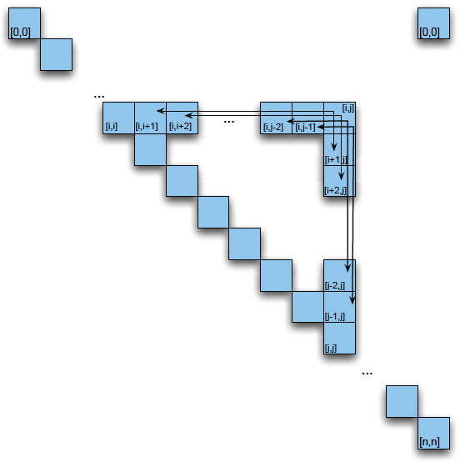
CKY Table

Slide 80
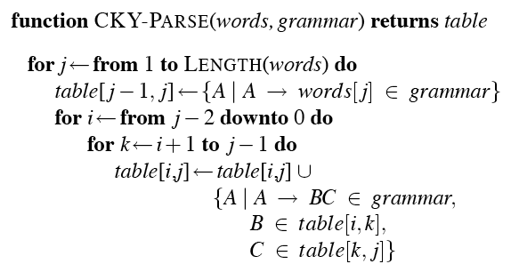
CKY Algorithm
What’s the complexity of this?

Slide 81
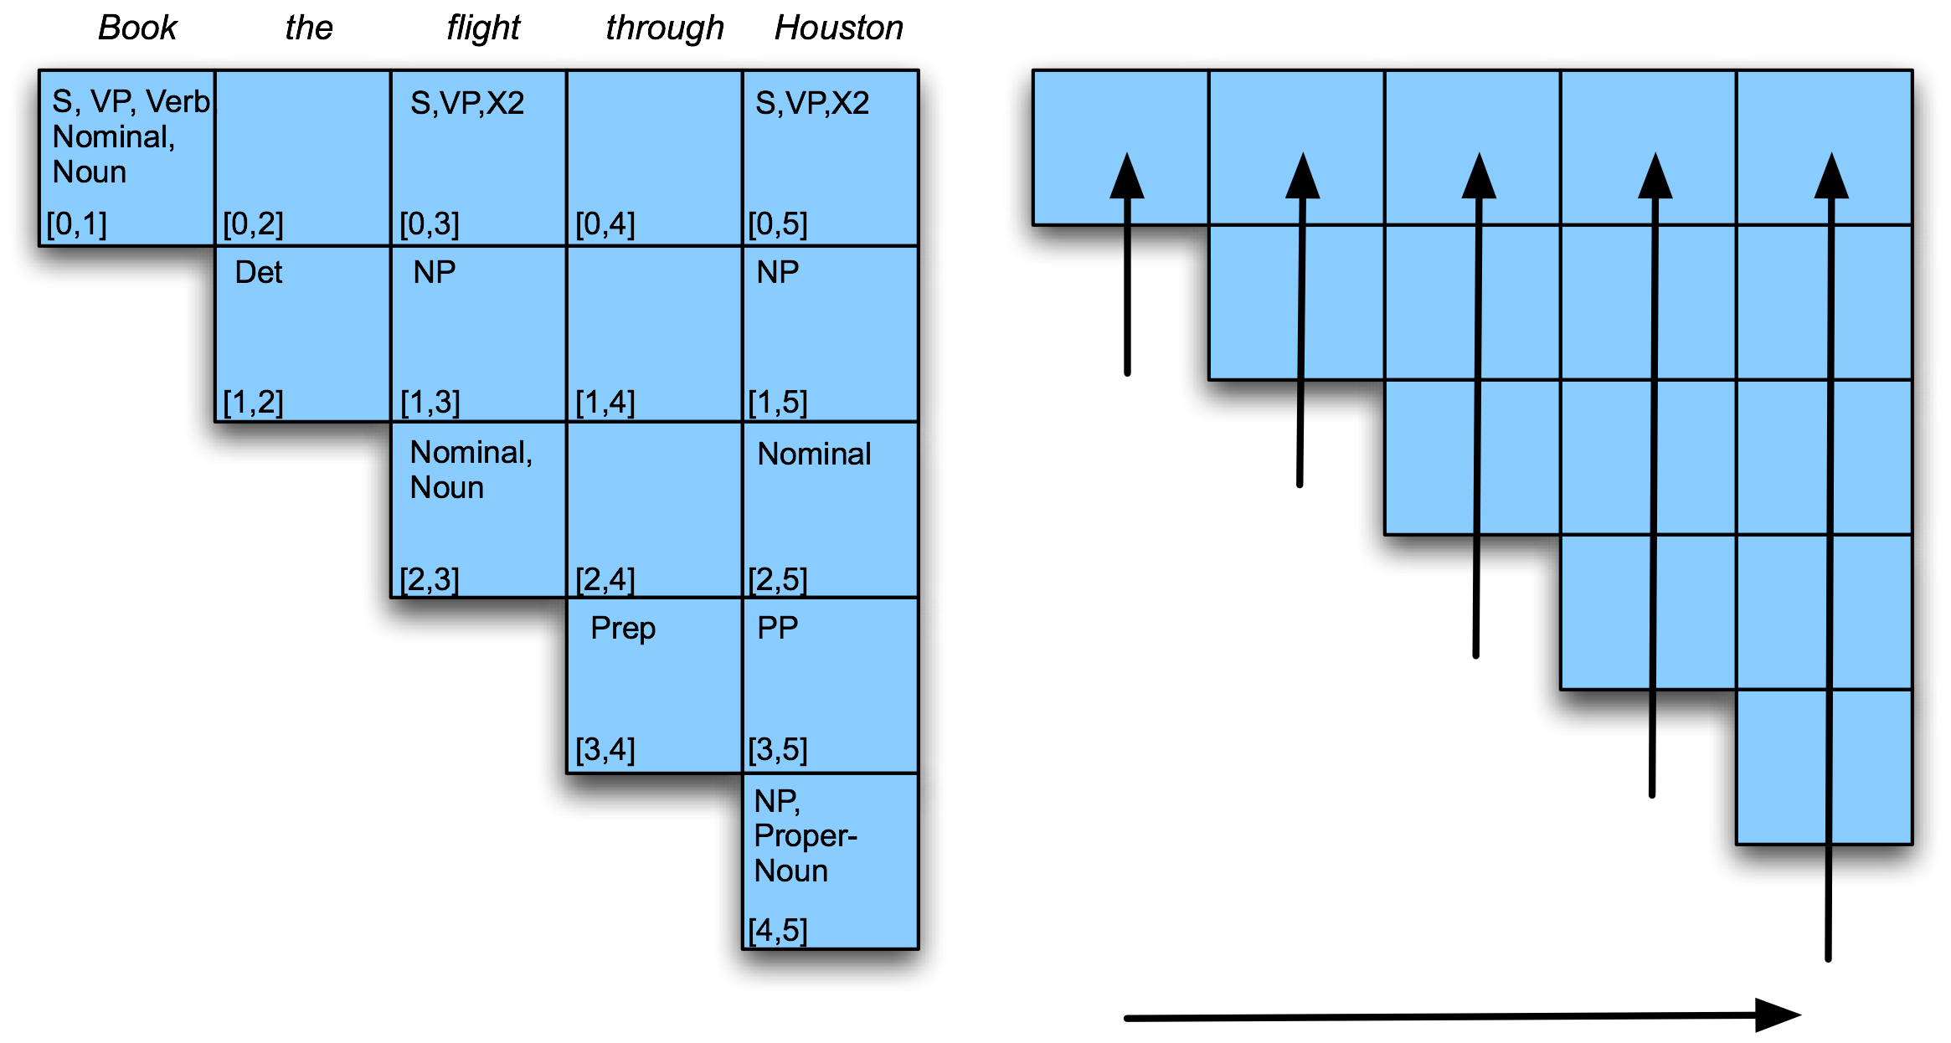
Example

Slide 82
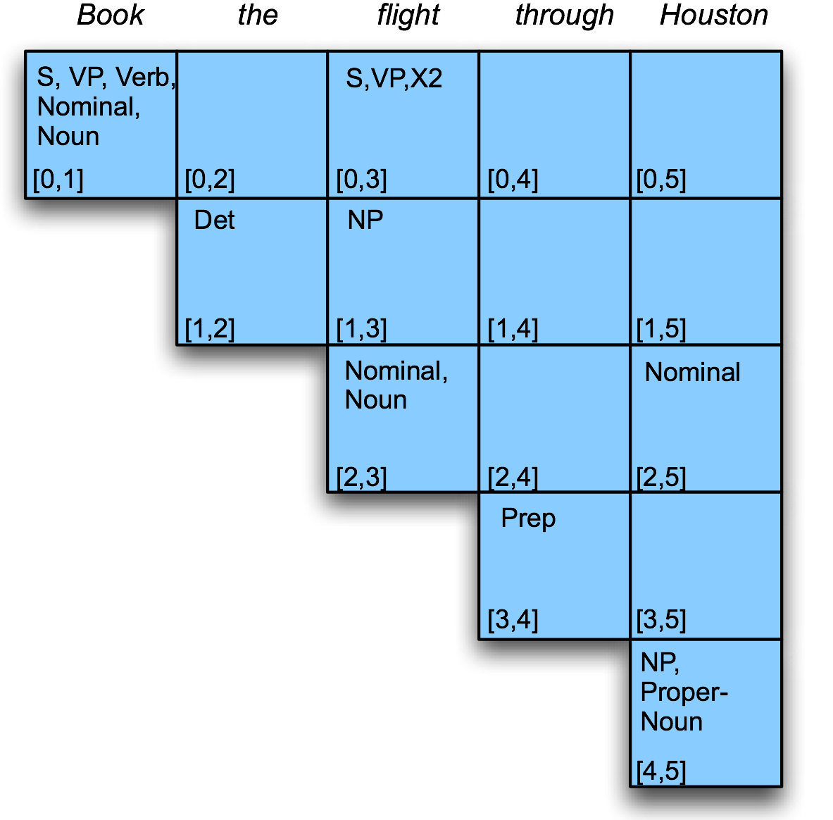
Example
Filling column 5

Slide 83
Example
Filling column 5 corresponds to processing word 5, which is Houston.
  So j is 5.
  So i goes from 3 to 0 (3,2,1,0)

Slide 84
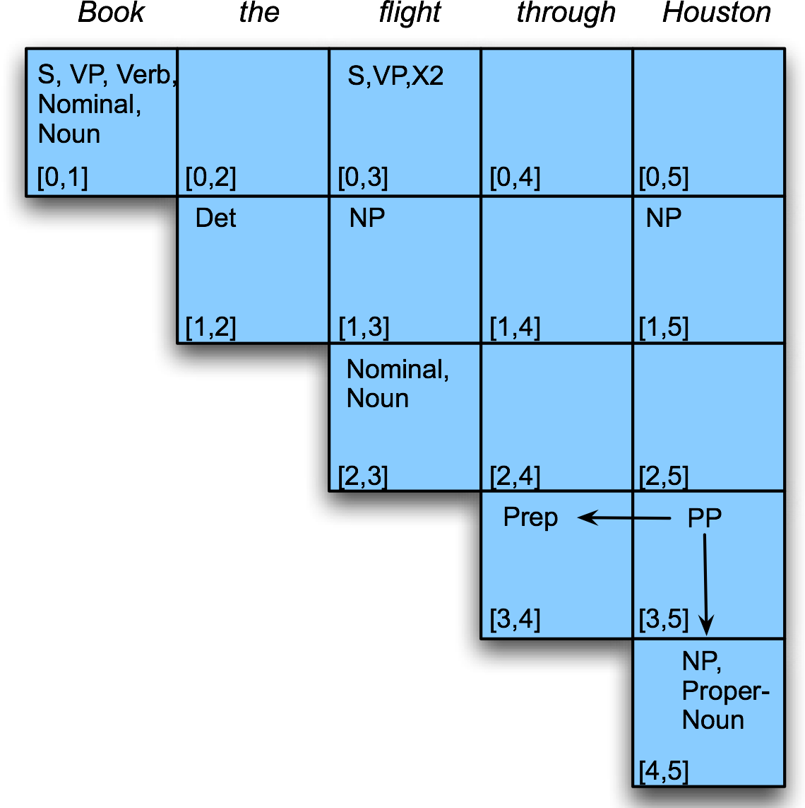
Example

Slide 85
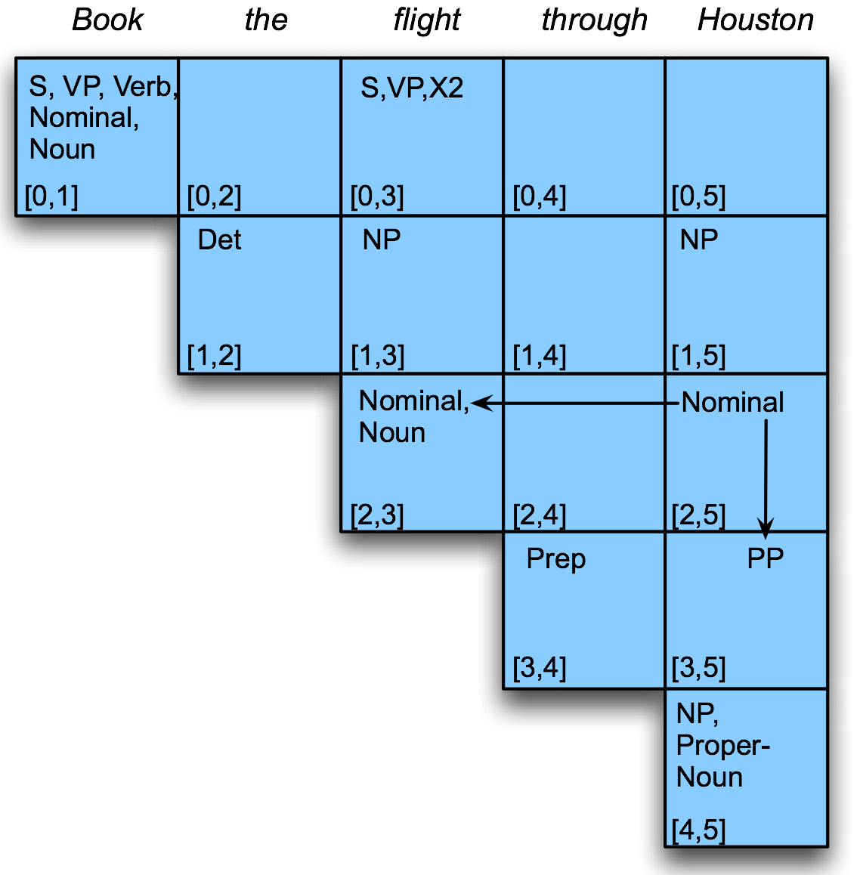
Example

Slide 86
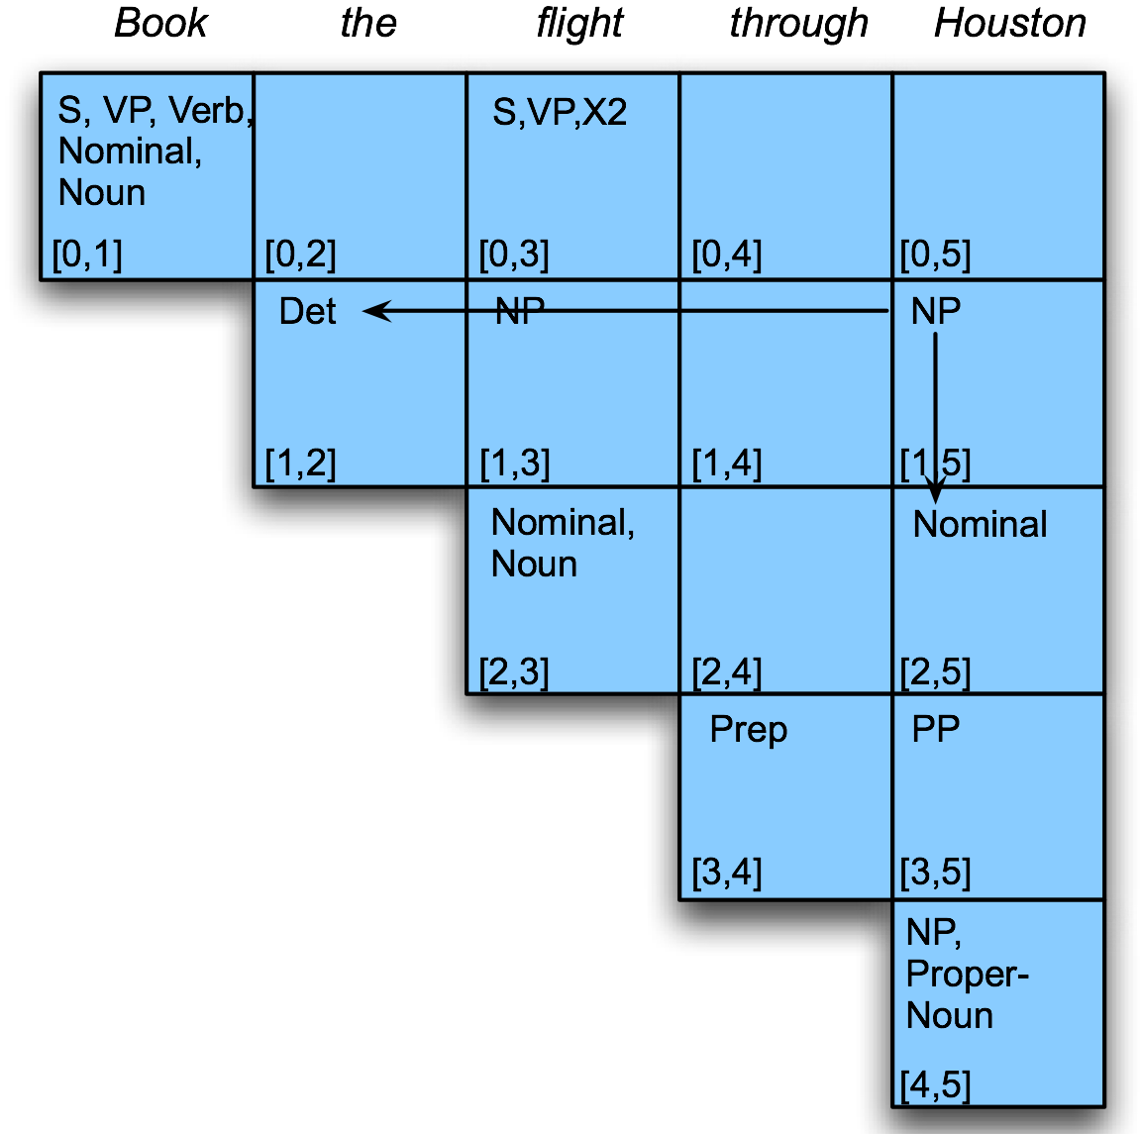
Example

Slide 87
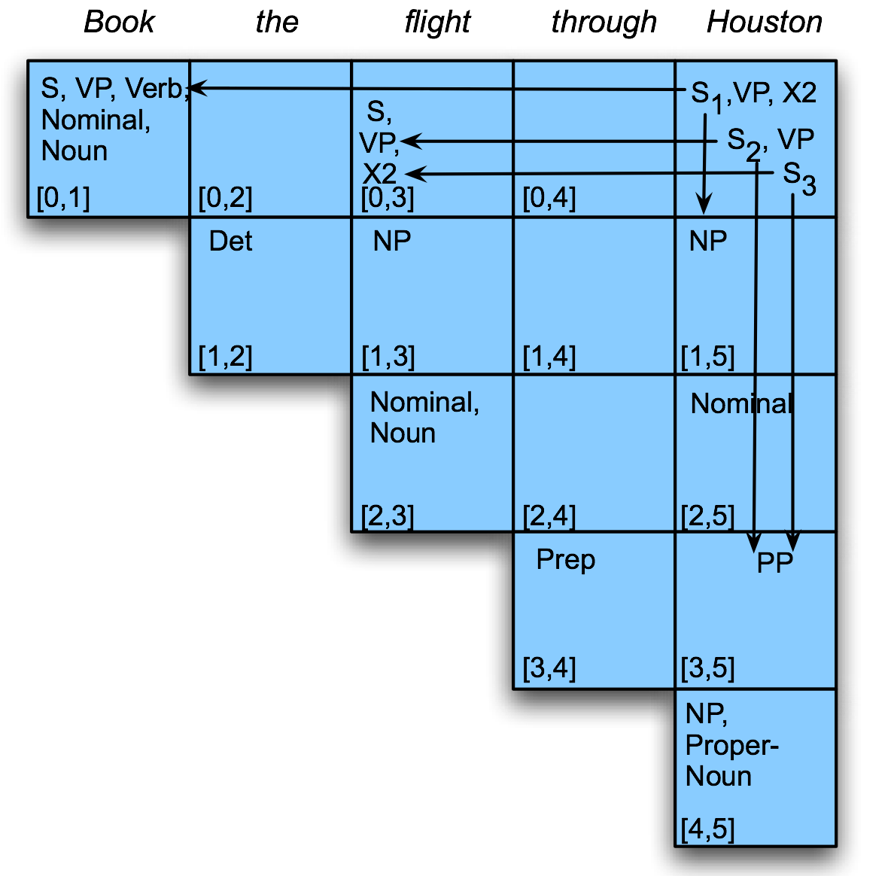
Example

Slide 88
Example
Since there’s an S in [0,5] we have a valid parse.
Are we done? We we sort of left something out of the algorithm

Slide 89
CKY Notes
Since it’s bottom up, CKY imagines a lot of silly constituents.
  Segments that by themselves are constituents but cannot really occur in the context in which they are being suggested.
  To avoid this we can switch to a top-down control strategy
  Or we can add some kind of filtering that blocks constituents where they can not happen in a final analysis.

Slide 90
CKY Notes
We arranged the loops to fill the table a column at a time, from left to right, bottom to top.
  This assures us that whenever we’re filling a cell, the parts needed to fill it are already in the table (to the left and below)
  It’s somewhat natural in that it processes the input a left to right a word at a time
    Known as online

Slide 91
Earley Parsing
Allows arbitrary CFGs
Where CKY is bottom-up, Earley is top-down
Fills a table in a single sweep over the input words
  Table is length N+1; N is number of words
  Table entries represent
    Completed constituents and their locations
    In-progress constituents
    Predicted constituents

Slide 92
Dynamic Programming
A standard T-D parser would reanalyze A FLIGHT 4 times, always in the same way
A DYNAMIC PROGRAMMING algorithm uses a table (the CHART) to avoid repeating work
The Earley algorithm also
  Does not suffer from the left-recursion problem
  Solves an exponential problem in O(n³)

Slide 93
The Chart
The Earley algorithm uses a table (the CHART) of size N+1, where N is the length of the input
  Table entries sit in the `gaps’ between words
Each entry in the chart is a list of
  Completed constituents
  In-progress constituents
  Predicted constituents
All three types of objects are represented in the same way as STATES

Slide 94

THE CHART:
GRAPHICAL REPRESENTATION

Slide 95
States
A state encodes two types of information:
  How much of a certain rule has been encountered in the input
  Which positions are covered
  A → α, [X,Y]
DOTTED RULES
  VP → V NP •
  NP → Det • Nominal
  S → • VP

Slide 96

Examples

Slide 97
Success
The parser has succeeded if entry N+1 of the chart contains the state
  S → α •, [0,N]

Slide 98
THE ALGORITHM
The algorithm loops through the input without backtracking, at each step performing three operations:
  PREDICTOR: add predictions to the chart
  COMPLETER: Move the dot to the right when looked-for constituent is found
  SCANNER: read in the next input word

Slide 99

THE ALGORITHM: CENTRAL LOOP

Slide 100

EARLEY ALGORITHM:
THE THREE OPERATORS

Slide 101


EXAMPLE, AGAIN

Slide 102

EXAMPLE:
BOOK THAT FLIGHT

Slide 103

EXAMPLE:
BOOK THAT FLIGHT (II)

Slide 104

EXAMPLE:
BOOK THAT FLIGHT (III)

Slide 105

EXAMPLE:
BOOK THAT FLIGHT (IV)

Slide 106
Graphically

Slide 107
Earley
As with most dynamic programming approaches, the answer is found by looking in the table in the right place.
In this case, there should be an S state in the final column that spans from 0 to n+1 and is complete.
If that’s the case you’re done.
  S –> α · [0,n+1]

Slide 108
Earley Algorithm
March through chart left-to-right.
At each step, apply 1 of 3 operators
  Predictor
    Create new states representing top-down expectations
  Scanner
    Match word predictions (rule with word after dot) to words
  Completer
    When a state is complete, see what rules were looking for that completed constituent

Slide 109
Earley’s example 1
Predict - Scan- Complete
John called Sue from Denver
S -> . NP VP
NP -> . NP PP
P -> . V NP
VP -> . VP PP
PP -> . P NP
NP -> . John
NP -> . Sue
NP -> . Denver
V -> . called
V ->. sue
P -> . from
S -> NP . VP
NP -> NP . PP
VP -> . V NP
VP -> . VP PP
PP -> . P NP
NP -> John .
NP -> . Sue
NP -> . Denver
V -> . called
V ->. sue
P -> . from
S -> . NP VP
NP -> . NP PP
NP -> . John
NP -> . Sue
NP -> . Denver

Slide 110
Earley’s example 2
John called Sue from Denver
S -> NP . VP
NP -> NP . PP
VP -> . V NP
VP -> . VP PP
PP -> . P NP
V -> . called
V ->. sue
P -> . from
S -> NP . VP
NP -> NP . PP
VP -> . V NP
VP -> . VP PP
PP -> . P NP
V -> . called
V ->. sue
P -> . from
S -> NP . VP
NP -> NP . PP
VP -> V . NP
V -> called .

Slide 111
Earley’s example 3
John called Sue from Denver
S -> NP . VP
NP -> NP . PP
VP -> V . NP
VP -> . VP PP
PP -> . P NP
NP -> . John
NP -> . Sue
NP -> . Denver
NP -> . Sue
S -> NP VP .
S -> NP . VP
NP -> NP . PP
VP -> V NP .
VP -> VP . PP
NP -> Sue .

Slide 112
Earley’s example 4
John called Sue from Denver
S -> NP . VP
NP -> NP . PP
VP -> V . NP
VP -> VP . PP
PP -> . P NP
P -> . from
S -> NP . VP
NP -> NP . PP
VP -> VP . PP
PP -> P . NP
P -> from .
P -> . from
NP -> Denver .
PP -> P NP .
NP -> NP PP .
VP -> VP PP .
VP -> V NP .
S -> NP VP .
NP -> . Denver
NP -> . John
NP -> . Sue
NP -> . Denver

Slide 113
Predictor
Given a state
  With a non-terminal to right of dot
  That is not a part-of-speech category
  Create a new state for each expansion of the non-terminal
  Place these new states into same chart entry as generated state, beginning and ending where generating state ends.
  So predictor looking at
    S -> . VP [0,0]
  results in
    VP -> . Verb [0,0]
    VP -> . Verb NP [0,0]

Slide 114
Scanner
Given a state
  With a non-terminal to right of dot
  That is a part-of-speech category
  If the next word in the input matches this part-of-speech
  Create a new state with dot moved over the non-terminal
  So scanner looking at
    VP -> . Verb NP [0,0]
  If the next word, “book”, can be a verb, add new state:
    VP -> Verb . NP [0,1]
  Add this state to chart entry following current one
  Note: Earley algorithm uses top-down input to disambiguate POS! Only POS predicted by some state can get added to chart!

Slide 115
Completer
Applied to a state when its dot has reached right end of role.
Parser has discovered a category over some span of input.
Find and advance all previous states that were looking for this category
  copy state, move dot, insert in current chart entry
Given:
  NP -> Det Nominal . [1,3]
  VP -> Verb. NP [0,1]
Add
  VP -> Verb NP . [0,3]

Slide 116
Earley: how do we know we are done?
How do we know when we are done?
Find an S state in the final column that spans from 0 to n+1 and is complete.
If that’s the case you’re done.
  S –> α · [0,n+1]

Slide 117
Earley
So sweep through the table from 0 to n+1…
  New predicted states are created by starting top-down from S
  New incomplete states are created by advancing existing states as new constituents are discovered
  New complete states are created in the same way.

Slide 118
Earley
More specifically…
  Predict all the states you can upfront
  Read a word
    Extend states based on matches
    Add new predictions
    Go to 2
  Look at N+1 to see if you have a winner

Slide 119
Example
Book that flight
We should find… an S from 0 to 3 that is a completed state…

Slide 120

Example

Slide 121

Example

Slide 122

Example

Slide 123
Details
What kind of algorithms did we just describe (both Earley and CKY)
  Not parsers – recognizers
    The presence of an S state with the right attributes in the right place indicates a successful recognition.
    But no parse tree… no parser
    That’s how we solve (not) an exponential problem in polynomial time

Slide 124
Back to Ambiguity
Did we solve it?

Slide 125

Ambiguity

Slide 126
Converting Earley from Recognizer to Parser
With the addition of a few pointers we have a parser
Augment the “Completer” to point to where we came from.

Slide 127
Augmenting the chart with structural information
S8
S9
S8
S10
S9
S11
S8
S12
S13

Slide 128
Retrieving Parse Trees from Chart
All the possible parses for an input are in the table
We just need to read off all the backpointers from every complete S in the last column of the table
Find all the S -> X . [0,N+1]
Follow the structural traces from the Completer
Of course, this won’t be polynomial time, since there could be an exponential number of trees
So we can at least represent ambiguity efficiently

Slide 129
Statistical Parsing
Statistical parsing uses a probabilistic model of syntax in order to assign probabilities to each parse tree.
Provides principled approach to resolving syntactic ambiguity.
Allows supervised learning of parsers from tree-banks of parse trees provided by human linguists.
Also allows unsupervised learning of parsers from unannotated text, but the accuracy of such parsers has been limited.

Slide 130
Probabilistic Context Free Grammar
(PCFG)
A PCFG is a probabilistic version of a CFG where each production has a probability.
Probabilities of all productions rewriting a given non-terminal must add to 1, defining a distribution for each non-terminal.
String generation is now probabilistic where production probabilities are used to non-deterministically select a production for rewriting a given non-terminal.

Slide 131
PCFGs – Notation
w_{1n} = w₁ … w_{n} = the word sequence from 1 to n (sentence of length n)
w_{ab} = the subsequence w_{a} … w_{b}
N^{j}_{ab} = the nonterminal N^{j} dominating w_{a} … w_{b}
N^{j}
w_{a} … w_{b}
We’ll write P(N^{i} → ζ^{j}) to mean P(N^{i} → ζ^{j} | N^{i} )
We’ll want to calculate max_{t} P(t ⇒* w_{ab})

Slide 132
The probability of trees and strings
P(w_{1n}, t) -- The probability of tree is the product of the probabilities of the rules used to generate it.
P(w_{1n}) -- The probability of the string is the sum of the probabilities of the trees which have that string as their yield
  P(w_{1n}) = Σ_{t} P(w_{1n}, t) where t is a parse of w_{1n}

Slide 133
Example: A Simple PCFG
(in Chomsky Normal Form)
S → NP VP 1.0 VP → V NP 0.7 VP → VP PP 0.3 PP → P NP 1.0 P → with 1.0 V → saw 1.0 | NP → NP PP 0.4 NP → astronomers 0.1 NP → ears 0.18 NP → saw 0.04 NP → stars 0.18 NP → telescope 0.1

Slide 134


Slide 135


Slide 136
Tree and String Probabilities
w₁₅ = astronomers saw stars with ears
P(t₁) = 1.0 * 0.1 * 0.7 * 1.0 * 0.4 * 0.18
* 1.0 * 1.0 * 0.18
= 0.0009072
P(t₂) = 1.0 * 0.1 * 0.3 * 0.7 * 1.0 * 0.18
* 1.0 * 1.0 * 0.18
= 0.0006804
P(w₁₅) = P(t₁) + P(t₂)
= 0.0009072 + 0.0006804
= 0.0015876

Slide 137
Simple PCFG for ATIS English
Grammar
Prob
Lexicon
S → NP VP
S → Aux NP VP
S → VP
NP → Pronoun
NP → Proper-Noun
NP → Det Nominal
Nominal → Noun
Nominal → Nominal Noun
Nominal → Nominal PP
VP → Verb
VP → Verb NP
VP → VP PP
PP → Prep NP
0.8
0.1
0.1
0.2
0.2
0.6
0.3
0.2
0.5
0.2
0.5
0.3
1.0
Det → the | a | that | this
0.6 0.2 0.1 0.1
Noun → book | flight | meal | money
0.1 0.5 0.2 0.2
Verb → book | include | prefer
0.5 0.2 0.3
Pronoun → I | he | she | me
0.5 0.1 0.1 0.3
Proper-Noun → Houston | NWA
0.8 0.2
Aux → does
1.0
Prep → from | to | on | near | through
0.25 0.25 0.1 0.2 0.2
+
1.0
+
1.0
+
1.0
+
1.0

Slide 138
Sentence Probability
Assume productions for each node are chosen independently.
Probability of derivation is the product of the probabilities of its productions.
P(D₁) = 0.1 x 0.5 x 0.5 x 0.6 x 0.6 x
0.5 x 0.3 x 1.0 x 0.2 x 0.2 x
0.5 x 0.8
⁼ 0.0000216
S
D₁
0.1
VP
0.5
Verb NP
0.6
0.5
book
Det Nominal
0.5
0.6
the
Nominal PP
1.0
0.3
Noun
Prep NP
0.2
0.5
0.2
flight
through
Proper-Noun
0.8
Houston

Slide 139
Syntactic Disambiguation
Resolve ambiguity by picking most probable parse tree.
S
D₂
P(D₂) = 0.1 x 0.3 x 0.5 x 0.6 x 0.5 x
0.6 x 0.3 x 1.0 x 0.5 x 0.2 x
0.2 x 0.8
⁼ 0.00001296
0.1
VP
0.3
VP
0.5
Verb NP
0.6
0.5
PP
book
Det Nominal
1.0
0.6
0.3
the
Noun
Prep NP
0.2
0.5
0.2
flight
through
Proper-Noun
0.8
Houston
139

Slide 140
Sentence Probability
Probability of a sentence is the sum of the probabilities of all of its derivations.
P(“book the flight through Houston”) =
P(D₁) + P(D₂) = 0.0000216 + 0.00001296
= 0.00003456

Slide 141
Three Useful PCFG Tasks
Observation likelihood: To classify and order sentences.
Most likely derivation: To determine the most likely parse tree for a sentence.
Maximum likelihood training: To train a PCFG to fit empirical training data.

Slide 142
PCFG: Most Likely Derivation
There is an analog to the Viterbi algorithm to efficiently determine the most probable derivation (parse tree) for a sentence.
John liked the dog in the pen.
S → NP VP
S → VP
NP → Det A N
NP → NP PP
NP → PropN
A → ε
A → Adj A
PP → Prep NP
VP → V NP
VP → VP PP
0.9
0.1
0.5
0.3
0.2
0.6
0.4
1.0
0.7
0.3
S
X
NP VP
PCFG
Parser
John V NP PP
liked the dog in the pen
English
Notes:
142

Slide 143
PCFG: Most Likely Derivation
There is an analog to the Viterbi algorithm to efficiently determine the most probable derivation (parse tree) for a sentence.
John liked the dog in the pen.
S → NP VP
S → VP
NP → Det A N
NP → NP PP
NP → PropN
A → ε
A → Adj A
PP → Prep NP
VP → V NP
VP → VP PP
0.9
0.1
0.5
0.3
0.2
0.6
0.4
1.0
0.7
0.3
S
NP VP
PCFG
Parser
John V NP
liked the dog in the pen
English
143
Notes:
143

Slide 144
Probabilistic CKY
CKY can be modified for PCFG parsing by including in each cell a probability for each non-terminal.
Cell[i,j] must retain the most probable derivation of each constituent (non-terminal) covering words i +1 through j together with its associated probability.
When transforming the grammar to CNF, must set production probabilities to preserve the probability of derivations.

Slide 145
Probabilistic Grammar Conversion
Original Grammar
Chomsky Normal Form
S → NP VP
S → Aux NP VP
S → VP
NP → Pronoun
NP → Proper-Noun
NP → Det Nominal
Nominal → Noun
Nominal → Nominal Noun
Nominal → Nominal PP
VP → Verb
VP → Verb NP
VP → VP PP
PP → Prep NP
S → NP VP
S → X1 VP
X1 → Aux NP
S → book | include | prefer
0.01 0.004 0.006
S → Verb NP
S → VP PP
NP → I | he | she | me
0.1 0.02 0.02 0.06
NP → Houston | NWA
0.16 .04
NP → Det Nominal
Nominal → book | flight | meal | money
0.03 0.15 0.06 0.06
Nominal → Nominal Noun
Nominal → Nominal PP
VP → book | include | prefer
0.1 0.04 0.06
VP → Verb NP
VP → VP PP
PP → Prep NP
0.8
0.1
0.1
0.2
0.2
0.6
0.3
0.2
0.5
0.2
0.5
0.3
1.0
0.8
0.1
1.0
0.05
0.03
0.6
0.2
0.5
0.5
0.3
1.0
Notes:
145

Slide 146
Probabilistic CKY Parser
Book the flight through Houston
S :.01, VP:.1,
Verb:.5
Nominal:.03
Noun:.1
None
NP:.6*.6*.15
=.054
Det:.6
Nominal:.15
Noun:.5
146
Notes:
146

Slide 147
Probabilistic CKY Parser
Book the flight through Houston
S :.01, VP:.1,
Verb:.5
Nominal:.03
Noun:.1
VP:.5*.5*.054
=.0135
None
NP:.6*.6*.15
=.054
Det:.6
Nominal:.15
Noun:.5
147
Notes:
147

Slide 148
Probabilistic CKY Parser
Book the flight through Houston
S :.01, VP:.1,
Verb:.5
Nominal:.03
Noun:.1
S:.05*.5*.054
=.00135
None
VP:.5*.5*.054
=.0135
NP:.6*.6*.15
=.054
Det:.6
Nominal:.15
Noun:.5
148
Notes:
148

Slide 149
Probabilistic CKY Parser
Book the flight through Houston
S :.01, VP:.1,
Verb:.5
Nominal:.03
Noun:.1
S:.05*.5*.054
=.00135
None
VP:.5*.5*.054
=.0135
None
NP:.6*.6*.15
=.054
Det:.6
None
Nominal:.15
Noun:.5
None
Prep:.2
149
Notes:
149

Slide 150
Probabilistic CKY Parser
Book the flight through Houston
S :.01, VP:.1,
Verb:.5
Nominal:.03
Noun:.1
S:.05*.5*.054
=.00135
None
VP:.5*.5*.054
=.0135
None
NP:.6*.6*.15
=.054
Det:.6
None
Nominal:.15
Noun:.5
None
Prep:.2
PP:1.0*.2*.16
=.032
NP:.16
PropNoun:.8
150
Notes:
150

Slide 151
Probabilistic CKY Parser
Book the flight through Houston
S :.01, VP:.1,
Verb:.5
Nominal:.03
Noun:.1
S:.05*.5*.054
=.00135
None
VP:.5*.5*.054
=.0135
None
NP:.6*.6*.15
=.054
Det:.6
None
Nominal:.15
Noun:.5
Nominal:
.5*.15*.032
=.0024
None
Prep:.2
PP:1.0*.2*.16
=.032
NP:.16
PropNoun:.8
151
Notes:
151

Slide 152
Probabilistic CKY Parser
Book the flight through Houston
S :.01, VP:.1,
Verb:.5
Nominal:.03
Noun:.1
S:.05*.5*.054
=.00135
None
VP:.5*.5*.054
=.0135
None
NP:.6*.6*
.0024
=.000864
NP:.6*.6*.15
=.054
Det:.6
None
Nominal:.15
Noun:.5
Nominal:
.5*.15*.032
=.0024
None
Prep:.2
PP:1.0*.2*.16
=.032
NP:.16
PropNoun:.8
152
Notes:
152

Slide 153
Probabilistic CKY Parser
Book the flight through Houston
S :.01, VP:.1,
Verb:.5
Nominal:.03
Noun:.1
S:.05*.5*.054
=.00135
S:.05*.5*
.000864
=.0000216
None
VP:.5*.5*.054
=.0135
None
NP:.6*.6*
.0024
=.000864
NP:.6*.6*.15
=.054
Det:.6
None
Nominal:.15
Noun:.5
Nominal:
.5*.15*.032
=.0024
None
Prep:.2
PP:1.0*.2*.16
=.032
NP:.16
PropNoun:.8
153
Notes:
153

Slide 154
Probabilistic CKY Parser
Book the flight through Houston
S :.01, VP:.1,
Verb:.5
Nominal:.03
Noun:.1
S:.05*.5*.054
=.00135
S:.03*.0135*
.032
=.00001296
None
VP:.5*.5*.054
=.0135
None
S:.0000216
NP:.6*.6*
.0024
=.000864
NP:.6*.6*.15
=.054
Det:.6
None
Nominal:.15
Noun:.5
Nominal:
.5*.15*.032
=.0024
None
Prep:.2
PP:1.0*.2*.16
=.032
NP:.16
PropNoun:.8
154
Notes:
154

Slide 155
Probabilistic CKY Parser
Book the flight through Houston
S :.01, VP:.1,
Verb:.5
Nominal:.03
Noun:.1
S:.05*.5*.054
=.00135
Pick most probable
parse, i.e. take max to
combine probabilities
of multiple derivations
of each constituent in
each cell.
S:.0000216
None
VP:.5*.5*.054
=.0135
None
NP:.6*.6*
.0024
=.000864
NP:.6*.6*.15
=.054
Det:.6
None
Nominal:.15
Noun:.5
Nominal:
.5*.15*.032
=.0024
None
Prep:.2
PP:1.0*.2*.16
=.032
NP:.16
PropNoun:.8
155
Notes:
155

Slide 156
PCFG: Observation Likelihood
There is an analog to Forward algorithm for HMMs called the Inside algorithm for efficiently determining how likely a string is to be produced by a PCFG.
Can use a PCFG as a language model to choose between alternative sentences for speech recognition or machine translation.
S → NP VP
S → VP
NP → Det A N
NP → NP PP
NP → PropN
A → ε
A → Adj A
PP → Prep NP
VP → V NP
VP → VP PP
0.9
0.1
0.5
0.3
0.2
0.6
0.4
1.0
0.7
0.3
O₁
?
The dog big barked.
?
The big dog barked
O₂
P(O₂ | English) > P(O₁ | English) ?
English

Slide 157
Inside Algorithm
Use CKY probabilistic parsing algorithm but combine probabilities of multiple derivations of any constituent using addition instead of max.

Slide 158
Probabilistic CKY Parser for Inside Computation
Book the flight through Houston
S :.01, VP:.1,
Verb:.5
Nominal:.03
Noun:.1
S:.05*.5*.054
=.00135
S:..00001296
None
VP:.5*.5*.054
=.0135
None
S:.0000216
NP:.6*.6*
.0024
=.000864
NP:.6*.6*.15
=.054
Det:.6
None
Nominal:.15
Noun:.5
Nominal:
.5*.15*.032
=.0024
None
Prep:.2
PP:1.0*.2*.16
=.032
NP:.16
PropNoun:.8
158
Notes:
158

Slide 159
Probabilistic CKY Parser for Inside Computation
Book the flight through Houston
S :.01, VP:.1,
Verb:.5
Nominal:.03
Noun:.1
S:.05*.5*.054
=.00135
S: .00001296
Sum probabilities
of multiple derivations
of each constituent in
each cell.
+.0000216
=.00003456
None
VP:.5*.5*.054
=.0135
None
NP:.6*.6*
.0024
=.000864
NP:.6*.6*.15
=.054
Det:.6
None
Nominal:.15
Noun:.5
Nominal:
.5*.15*.032
=.0024
None
Prep:.2
PP:1.0*.2*.16
=.032
NP:.16
PropNoun:.8
159
Notes:
159

Slide 160
PCFG: Supervised Training
If parse trees are provided for training sentences, a grammar and its parameters can be can all be estimated directly from counts accumulated from the tree-bank (with appropriate smoothing).
Tree Bank
S
NP VP
S → NP VP
S → VP
NP → Det A N
NP → NP PP
NP → PropN
A → ε
A → Adj A
PP → Prep NP
VP → V NP
VP → VP PP
0.9
0.1
0.5
0.3
0.2
0.6
0.4
1.0
0.7
0.3
John V NP PP
put the dog in the pen
S
Supervised
PCFG
Training
NP VP
John V NP PP
put the dog in the pen
.
.
.
English

Slide 161
Estimating Production Probabilities
Set of production rules can be taken directly from the set of rewrites in the treebank.
Parameters can be directly estimated from frequency counts in the treebank.

Slide 162
PCFG: Maximum Likelihood Training
Given a set of sentences, induce a grammar that maximizes the probability that this data was generated from this grammar.
Assume the number of non-terminals in the grammar is specified.
Only need to have an unannotated set of sequences generated from the model. Does not need correct parse trees for these sentences. In this sense, it is unsupervised.

Slide 163
PCFG: Maximum Likelihood Training
Training Sentences
S → NP VP
S → VP
NP → Det A N
NP → NP PP
NP → PropN
A → ε
A → Adj A
PP → Prep NP
VP → V NP
VP → VP PP
0.9
0.1
0.5
0.3
0.2
0.6
0.4
1.0
0.7
0.3
John ate the apple
A dog bit Mary
Mary hit the dog
John gave Mary the cat.
PCFG
Training
.
.
.
English

Slide 164
Inside-Outside
The Inside-Outside algorithm is a version of EM for unsupervised learning of a PCFG.
  Analogous to Baum-Welch (forward-backward) for HMMs
Given the number of non-terminals, construct all possible CNF productions with these non-terminals and observed terminal symbols.
Use EM to iteratively train the probabilities of these productions to locally maximize the likelihood of the data.
  See Manning and Schütze text for details
Experimental results are not impressive, but recent work imposes additional constraints to improve unsupervised grammar learning.

Slide 165
Vanilla PCFG Limitations
Since probabilities of productions do not rely on specific words or concepts, only general structural disambiguation is possible (e.g. prefer to attach PPs to Nominals).
Consequently, vanilla PCFGs cannot resolve syntactic ambiguities that require semantics to resolve, e.g. ate with fork vs. meatballs.
In order to work well, PCFGs must be lexicalized, i.e. productions must be specialized to specific words by including their head-word in their LHS non-terminals (e.g. VP-ate).

Slide 166
Example of Importance of Lexicalization
A general preference for attaching PPs to NPs rather than VPs can be learned by a vanilla PCFG.
But the desired preference can depend on specific words.
John put the dog in the pen.
S → NP VP
S → VP
NP → Det A N
NP → NP PP
NP → PropN
A → ε
A → Adj A
PP → Prep NP
VP → V NP
VP → VP PP
0.9
0.1
0.5
0.3
0.2
0.6
0.4
1.0
0.7
0.3
S
NP VP
PCFG
Parser
John V NP PP
put the dog in the pen
English
166

Slide 167
Example of Importance of Lexicalization
A general preference for attaching PPs to NPs rather than VPs can be learned by a vanilla PCFG.
But the desired preference can depend on specific words.
John put the dog in the pen.
S → NP VP
S → VP
NP → Det A N
NP → NP PP
NP → PropN
A → ε
A → Adj A
PP → Prep NP
VP → V NP
VP → VP PP
0.9
0.1
0.5
0.3
0.2
0.6
0.4
1.0
0.7
0.3
S
X
NP VP
PCFG
Parser
John V NP
put the dog in the pen
English
167
Notes:
167

Slide 168
Head Words
Syntactic phrases usually have a word in them that is most “central” to the phrase.
Linguists have defined the concept of a lexical head of a phrase.
Simple rules can identify the head of any phrase by percolating head words up the parse tree.
  Head of a VP is the main verb
  Head of an NP is the main noun
  Head of a PP is the preposition
  Head of a sentence is the head of its VP

Slide 169
Lexicalized Productions
Specialized productions can be generated by including the head word and its POS of each non-terminal as part of that non-terminal’s symbol.
S
liked-VBD
NP
John-NNP
VP
liked-VBD
NNP
VBD NP
dog-NN
Nominaldog-NN → Nominaldog-NN PPin-IN
John
liked
DT Nominal
dog-NN
the
Nominal PP
in-IN
dog-NN
NN
IN NP
pen-NN
dog
in
DT Nominal
pen-NN
the
NN
pen

Slide 170
Lexicalized Productions
S
put-VBD
NP
John-NNP
VP
put-VBD
VPput-VBD → VPput-VBD PPin-IN
NNP
VP PP
in-IN
put-VBD
John
VBD
NP
dog-NN
IN NP
pen-NN
put
DT Nominal
in
DT Nominal
pen-NN
dog-NN
the
the
NN
NN
dog
pen

Slide 171
Parameterizing Lexicalized Productions
Accurately estimating parameters on such a large number of very specialized productions could require enormous amounts of treebank data.
Need some way of estimating parameters for lexicalized productions that makes reasonable independence assumptions so that accurate probabilities for very specific rules can be learned.

Slide 172
Collins Parser
Collins (1999) parser assumes a simple generative model of lexicalized productions.
Models productions based on context to the left and the right of the head daughter.
  LHS → L_{n}L_{n−1}…L₁H R₁…R_{m−1}R_{m}
First generate the head (H) and then repeatedly generate left (L_{i}) and right (R_{i}) context symbols until the symbol STOP is generated.

Slide 173
Sample Production Generation
Note: Penn treebank tends to
have fairly flat parse trees that
produce long productions.
VPput-VBD → VBDput-VBD NPdog-NN PPin-IN
VPput-VBD →
STOP
VBDput-VBD
NPdog-NN
PPin-IN
STOP
L₁
H
R₁
R₂
R₃
P_{L}(STOP | VPput-VBD) * P_{H}(VBD | Vpput-VBD)*
P_{R}(NPdog-NN | VPput-VBD)*
P_{R}(PPin-IN | VPput-VBD) * P_{R}(STOP | VPput-VBD)

Slide 174
Estimating Production Generation Parameters
Estimate P_{H}, P_{L}, and P_{R} parameters from treebank data.
Count(PPin-IN right of head in a VPput-VBD production)
P_{R}(PPin-IN | VPput-VBD) =
Count(symbol right of head in a VPput-VBD)
Count(NPdog-NN right of head in a VPput-VBD production)
P_{R}(NPdog-NN | VPput-VBD) =
Count(symbol right of head in a VPput-VBD)
Smooth estimates by linearly interpolating with simpler models conditioned on just POS tag or no lexical info.
smP_{R}(PPin-IN | VPput-VBD) = λ₁ P_{R}(PPin-IN | VPput-VBD)
+ (1− λ₁) (λ₂ P_{R}(PPin-IN | VPVBD) +
(1− λ₂) P_{R}(PPin-IN | VP))

Slide 175
Missed Context Dependence
Another problem with CFGs is that which production is used to expand a non-terminal is independent of its context.
However, this independence is frequently violated for normal grammars.
  NPs that are subjects are more likely to be pronouns than NPs that are objects.

Slide 176
Splitting Non-Terminals
To provide more contextual information, non-terminals can be split into multiple new non-terminals based on their parent in the parse tree using parent annotation.
  A subject NP becomes NP^S since its parent node is an S.
  An object NP becomes NP^VP since its parent node is a VP

Slide 177
Parent Annotation Example
S
NP
^S
VP
^S
VP^S → VBD^VP NP^VP
NNP
^NP
VBD NP
^VP
^VP
John
liked
DT Nominal
^NP
^NP
the
Nominal PP
^Nominal
^Nominal
NN
IN NP
^PP
^PP
^Nominal
dog
in
^NP
DT Nominal
^NP
the
NN
^Nominal
pen

Slide 178
Split and Merge
Non-terminal splitting greatly increases the size of the grammar and the number of parameters that need to be learned from limited training data.
Best approach is to only split non-terminals when it improves the accuracy of the grammar.
May also help to merge some non-terminals to remove some un-helpful distinctions and learn more accurate parameters for the merged productions.
Method: Heuristically search for a combination of splits and merges that produces a grammar that maximizes the likelihood of the training treebank.

Slide 179
Treebanks
English Penn Treebank: Standard corpus for testing syntactic parsing consists of 1.2 M words of text from the Wall Street Journal (WSJ).
Typical to train on about 40,000 parsed sentences and test on an additional standard disjoint test set of 2,416 sentences.
Chinese Penn Treebank: 100K words from the Xinhua news service.
Other corpora existing in many languages, see the Wikipedia article “Treebank”

Slide 180
First WSJ Sentence
( (S
(NP-SBJ
(NP (NNP Pierre) (NNP Vinken) )
(, ,)
(ADJP
(NP (CD 61) (NNS years) )
(JJ old) )
(, ,) )
(VP (MD will)
(VP (VB join)
(NP (DT the) (NN board) )
(PP-CLR (IN as)
(NP (DT a) (JJ nonexecutive) (NN director) ))
(NP-TMP (NNP Nov.) (CD 29) )))
(. .) ))

Slide 181
WSJ Sentence with Trace (NONE)
( (S
(NP-SBJ (DT The) (NNP Illinois) (NNP Supreme) (NNP Court) )
(VP (VBD ordered)
(NP-1 (DT the) (NN commission) )
(S
(NP-SBJ (-NONE- *-1) )
(VP (TO to)
(VP
(VP (VB audit)
(NP
(NP (NNP Commonwealth) (NNP Edison) (POS 's) )
(NN construction) (NNS expenses) ))
(CC and)
(VP (VB refund)
(NP (DT any) (JJ unreasonable) (NNS expenses) ))))))
(. .) ))

Slide 182
Parsing Evaluation Metrics
PARSEVAL metrics measure the fraction of the constituents that match between the computed and human parse trees. If P is the system’s parse tree and T is the human parse tree (the “gold standard”):
  Recall = (# correct constituents in P) / (# constituents in T)
  Precision = (# correct constituents in P) / (# constituents in P)
Labeled Precision and labeled recall require getting the non-terminal label on the constituent node correct to count as correct.
F₁ is the harmonic mean of precision and recall.

Slide 183
Computing Evaluation Metrics
Correct Tree T
Computed Tree P
S
S
VP
VP
Verb NP
VP
book
Det Nominal
Verb NP
the
Nominal PP
Det Nominal
PP
book
Noun
Prep NP
the
Noun
Prep NP
flight
through
Proper-Noun
flight
through
Proper-Noun
Houston
Houston
# Constituents: 12
# Constituents: 12
# Correct Constituents: 10
Recall = 10/12= 83.3%
Precision = 10/12=83.3%
F₁ = 83.3%

Slide 184
Treebank Results
Results of current state-of-the-art systems on the English Penn WSJ treebank are slightly greater than 90% labeled precision and recall.

Slide 185
Discriminative Parse Reranking
Motivation: Even when the top-ranked parse not correct, frequently the correct parse is one of those ranked highly by a statistical parser.
Use a discriminative classifier that is trained to select the best parse from the N-best parses produced by the original parser.
Reranker can exploit global features of the entire parse whereas a PCFG is restricted to making decisions based on local info.

Slide 186
2-Stage Reranking Approach
Adapt the PCFG parser to produce an N-best list of the most probable parses in addition to the most-likely one.
Extract from each of these parses, a set of global features that help determine if it is a good parse tree.
Train a discriminative classifier (e.g. logistic regression) using the best parse in each N-best list as positive and others as negative.

Slide 187
Parse Reranking
PCFG Parser
N-Best Parse Trees
sentence
Parse Tree
Feature
Extractor
Best Parse Tree
Discriminative
Parse Tree
Classifier
Parse Tree Descriptions

Slide 188
Sample Parse Tree Features
Probability of the parse from the PCFG.
The number of parallel conjuncts.
  “the bird in the tree and the squirrel on the ground”
  “the bird and the squirrel in the tree”
The degree to which the parse tree is right branching.
  English parses tend to be right branching (cf. parse of “Book the flight through Houston”)
Frequency of various tree fragments, i.e. specific combinations of 2 or 3 rules.

Slide 189
Evaluation of Reranking
Reranking is limited by oracle accuracy, i.e. the accuracy that results when an omniscient oracle picks the best parse from the N-best list.
Typical current oracle accuracy is around F₁=97%
Reranking can generally improve test accuracy of current PCFG models a percentage point or two.

Slide 190
Other Discriminative Parsing
There are also parsing models that move from generative PCFGs to a fully discriminative model, e.g. max margin parsing (Taskar et al., 2004).
There is also a recent model that efficiently reranks all of the parses in the complete (compactly-encoded) parse forest, avoiding the need to generate an N-best list (forest reranking, Huang, 2008).

Slide 191
Human Parsing
Computational parsers can be used to predict human reading time as measured by tracking the time taken to read each word in a sentence.
Psycholinguistic studies show that words that are more probable given the preceding lexical and syntactic context are read faster.
  John put the dog in the pen with a lock.
  John put the dog in the pen with a bone in the car.
  John liked the dog in the pen with a bone.
Modeling these effects requires an incremental statistical parser that incorporates one word at a time into a continuously growing parse tree.

Slide 192
Garden Path Sentences
People are confused by sentences that seem to have a particular syntactic structure but then suddenly violate this structure, so the listener is “lead down the garden path”.
  The horse raced past the barn fell.
    vs. The horse raced past the barn broke his leg.
  The complex houses married students.
  The old man the sea.
  While Anna dressed the baby spit up on the bed.
Incremental computational parsers can try to predict and explain the problems encountered parsing such sentences.

Slide 193
Center Embedding
Nested expressions are hard for humans to process beyond 1 or 2 levels of nesting.
  The rat the cat chased died.
  The rat the cat the dog bit chased died.
  The rat the cat the dog the boy owned bit chased died.
Requires remembering and popping incomplete constituents from a stack and strains human short-term memory.
Equivalent “tail embedded” (tail recursive) versions are easier to understand since no stack is required.
  The boy owned a dog that bit a cat that chased a rat that died.

Slide 194
Dependency Grammars
An alternative to phrase-structure grammar is to define a parse as a directed graph between the words of a sentence representing dependencies between the words.
liked
liked
Typed
dependency
parse
nsubj
dobj
John
dog
John
dog
det
in
the
in
the
pen
pen
det
the
the

Slide 195
Dependency Graph from Parse Tree
Can convert a phrase structure parse to a dependency tree by making the head of each non-head child of a node depend on the head of the head child.
S
liked-VBD
liked
NP
John-NNP
VP
liked-VBD
VBD NP
John
dog
NNP
dog-NN
John
liked
DT Nominal
dog-NN
the
in
the
Nominal PP
in-IN
dog-NN
pen
NN
IN NP
pen-NN
dog
the
in
DT Nominal
pen-NN
the
NN
pen

Slide 196
Unification Grammars
In order to handle agreement issues more effectively, each constituent has a list of features such as number, person, gender, etc. which may or not be specified for a given constituent.
In order for two constituents to combine to form a larger constituent, their features must unify, i.e. consistently combine into a merged set of features.
Expressive grammars and parsers (e.g. HPSG) have been developed using this approach and have been partially integrated with modern statistical models of disambiguation.

Slide 197
Mildly Context-Sensitive Grammars
Some grammatical formalisms provide a degree of context-sensitivity that helps capture aspects of NL syntax that are not easily handled by CFGs.
Tree Adjoining Grammar (TAG) is based on combining tree fragments rather than individual phrases.
Combinatory Categorial Grammar (CCG) consists of:
  Categorial Lexicon that associates a syntactic and semantic category with each word.
  Combinatory Rules that define how categories combine to form other categories.

Slide 198
Statistical Parsing Conclusions
Statistical models such as PCFGs allow for probabilistic resolution of ambiguities.
PCFGs can be easily learned from treebanks.
Lexicalization and non-terminal splitting are required to effectively resolve many ambiguities.
Current statistical parsers are quite accurate but not yet at the level of human-expert agreement.

